Slide 1
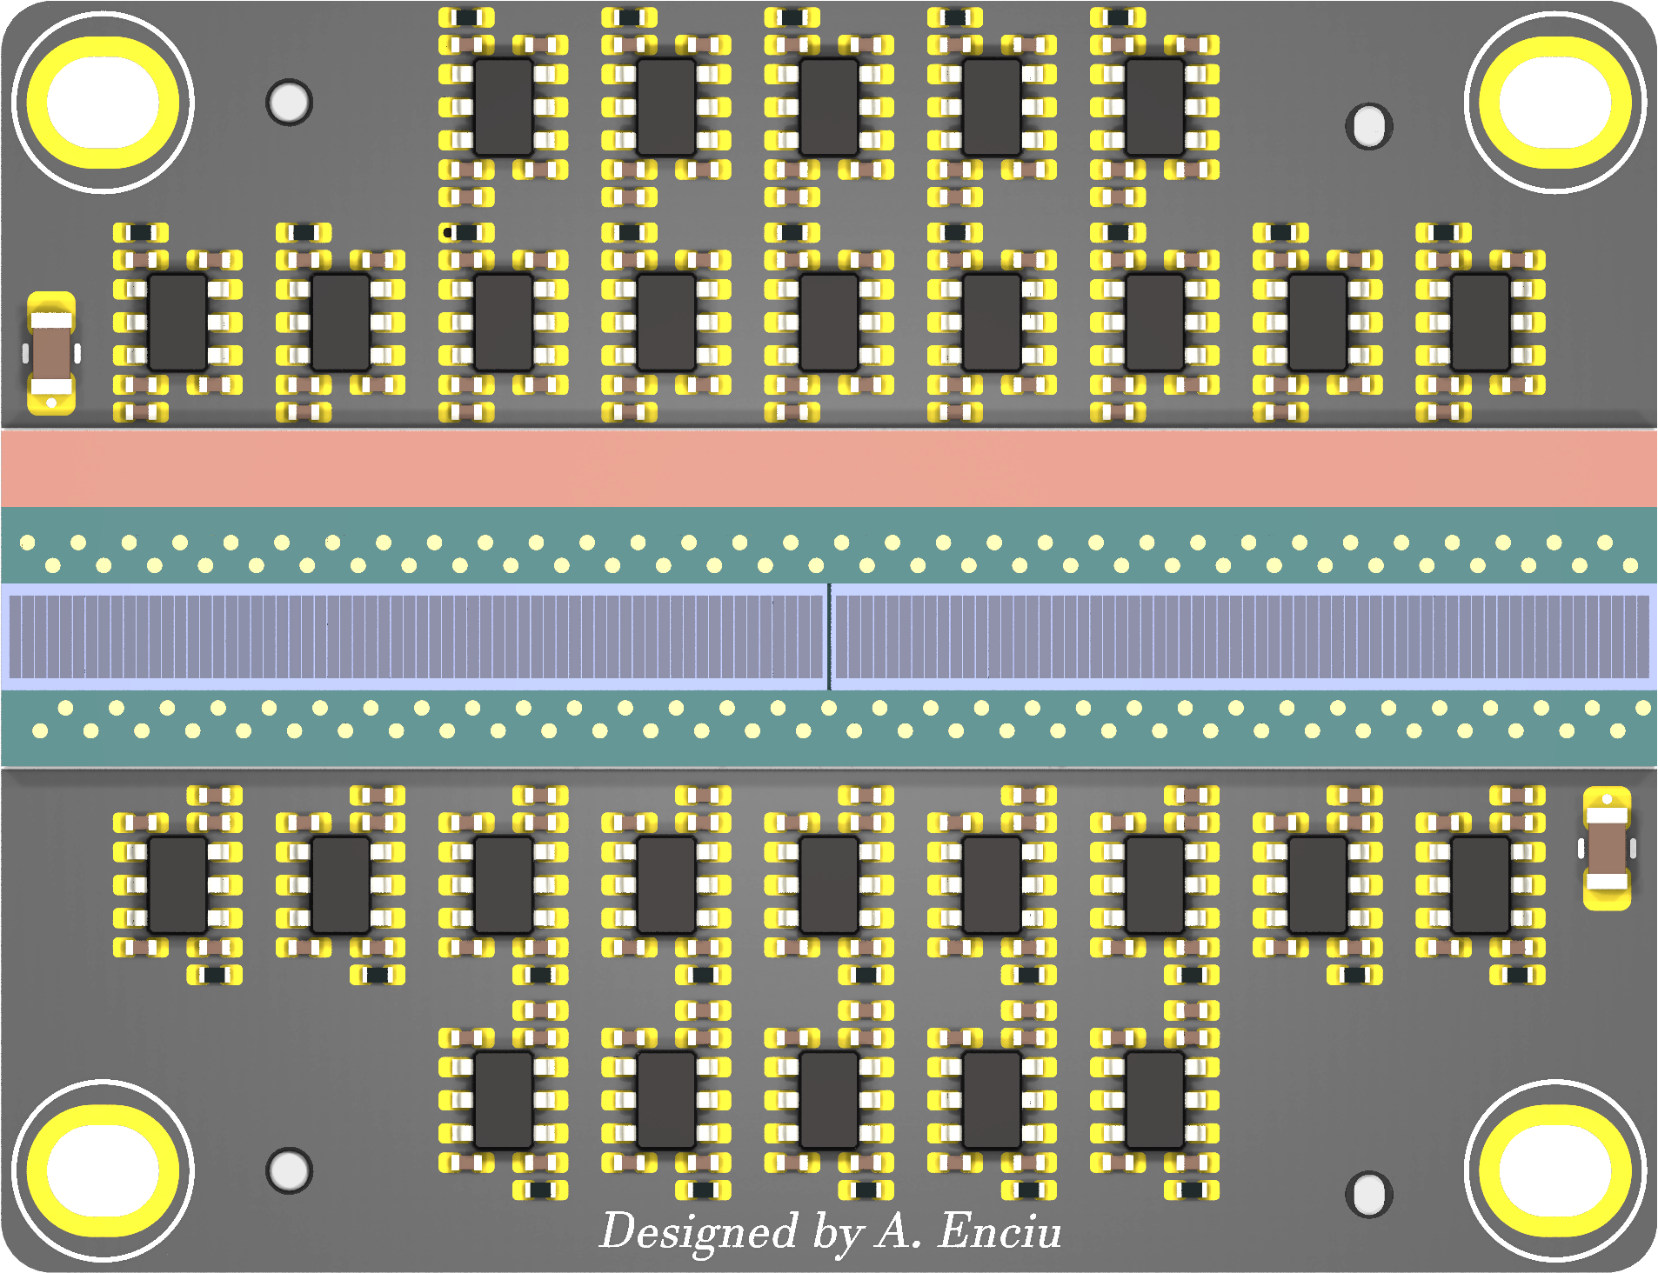
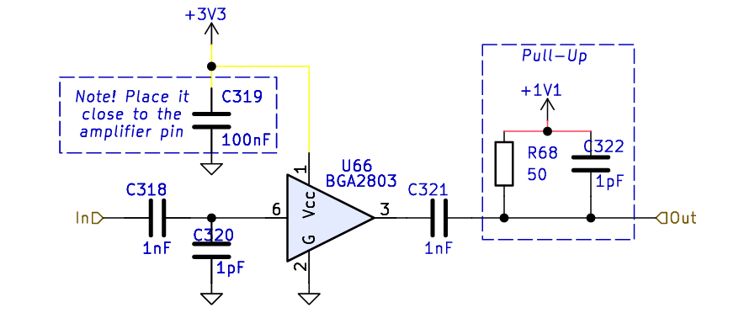
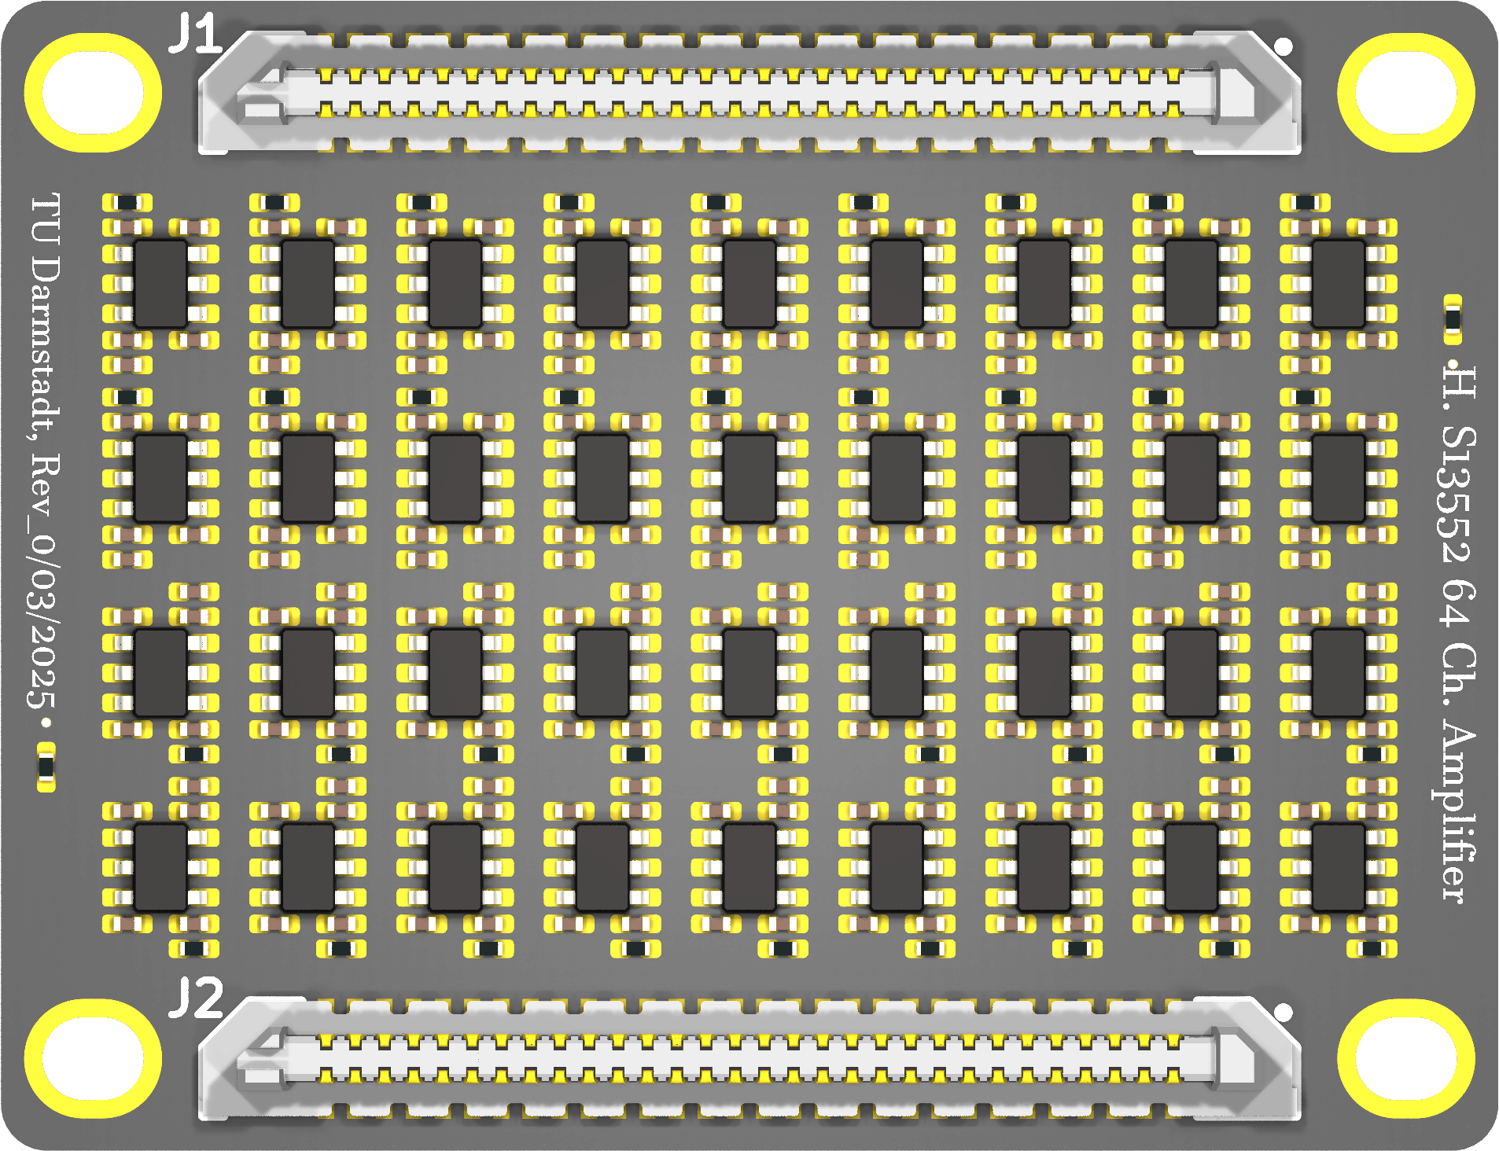
New Amplifier Based on PADIWA3
TOP VIEW
BOTTOM VIEW
page_4: https://jspc29.x-matter.uni-frankfurt.de/trb/schematics/PADIWA3-all.pdf
W. Zhi et al 2024 JINST 19 P06011 DOI 10.1088/1748-0221/19/06/P06011
Joshua W Cates et al 2018 Phys. Med. Biol. 63 185022 DOI 10.1088/1361-6560/aadbcd
F. Simon NIM-A Volume 926, 11 May 2019, Pages 85-100 Doi.org/10.1016/j.nima.2018.11.042

Slide 2
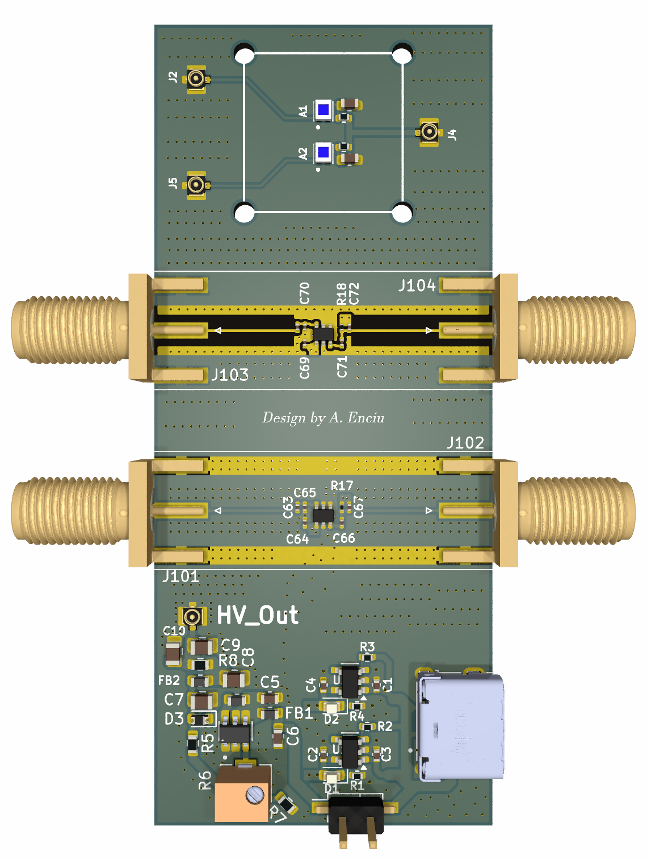
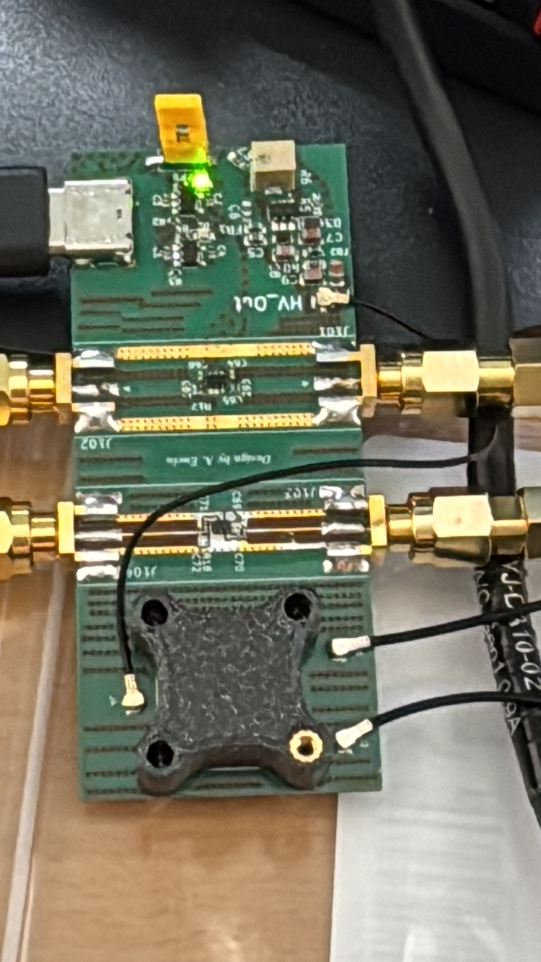
BGA2803 Demo Board
2 RF amplifiers
2 SiPMs
1 HV PSU
Power via USB-C

Slide 3
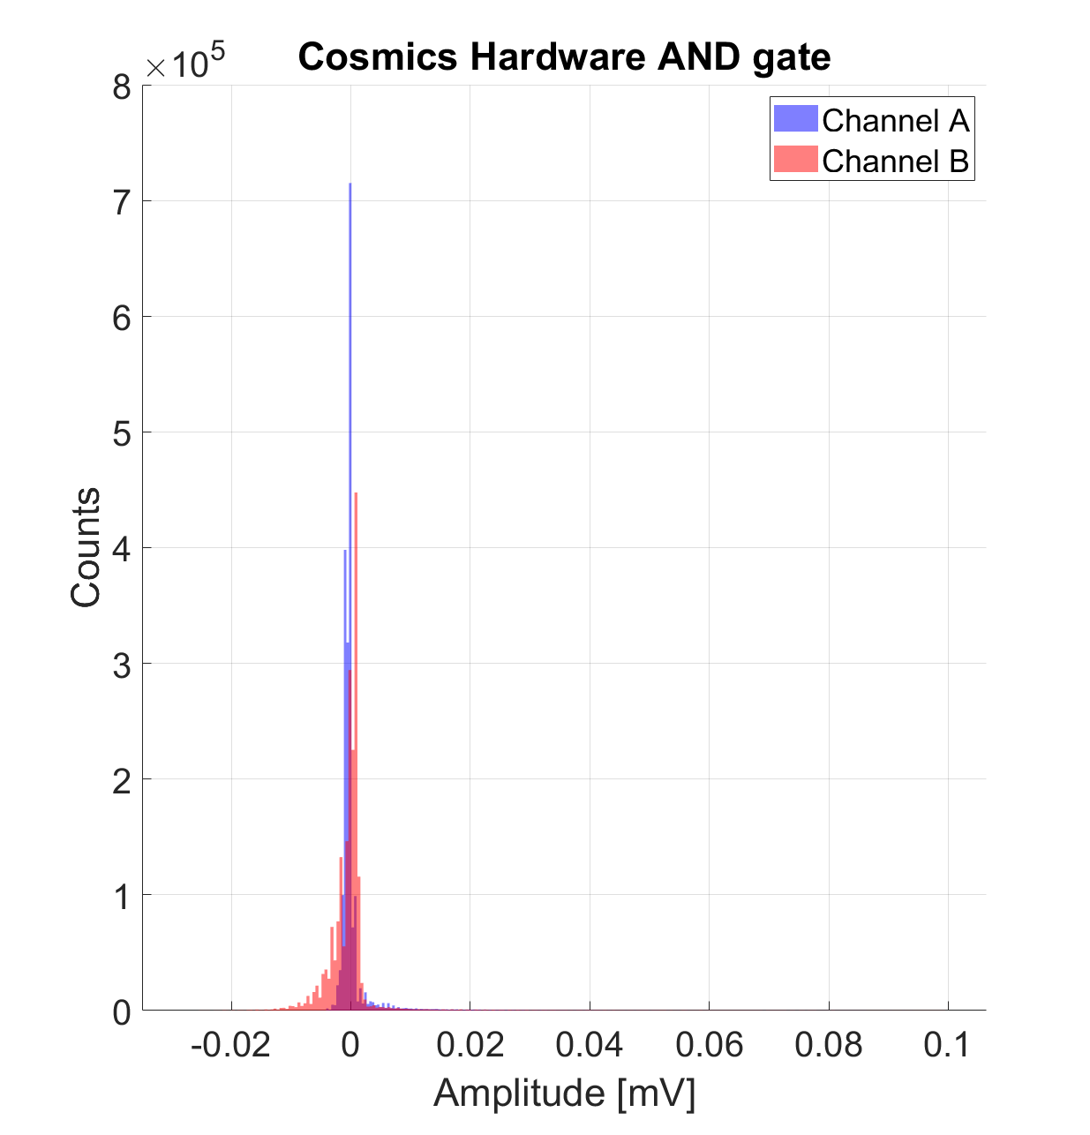
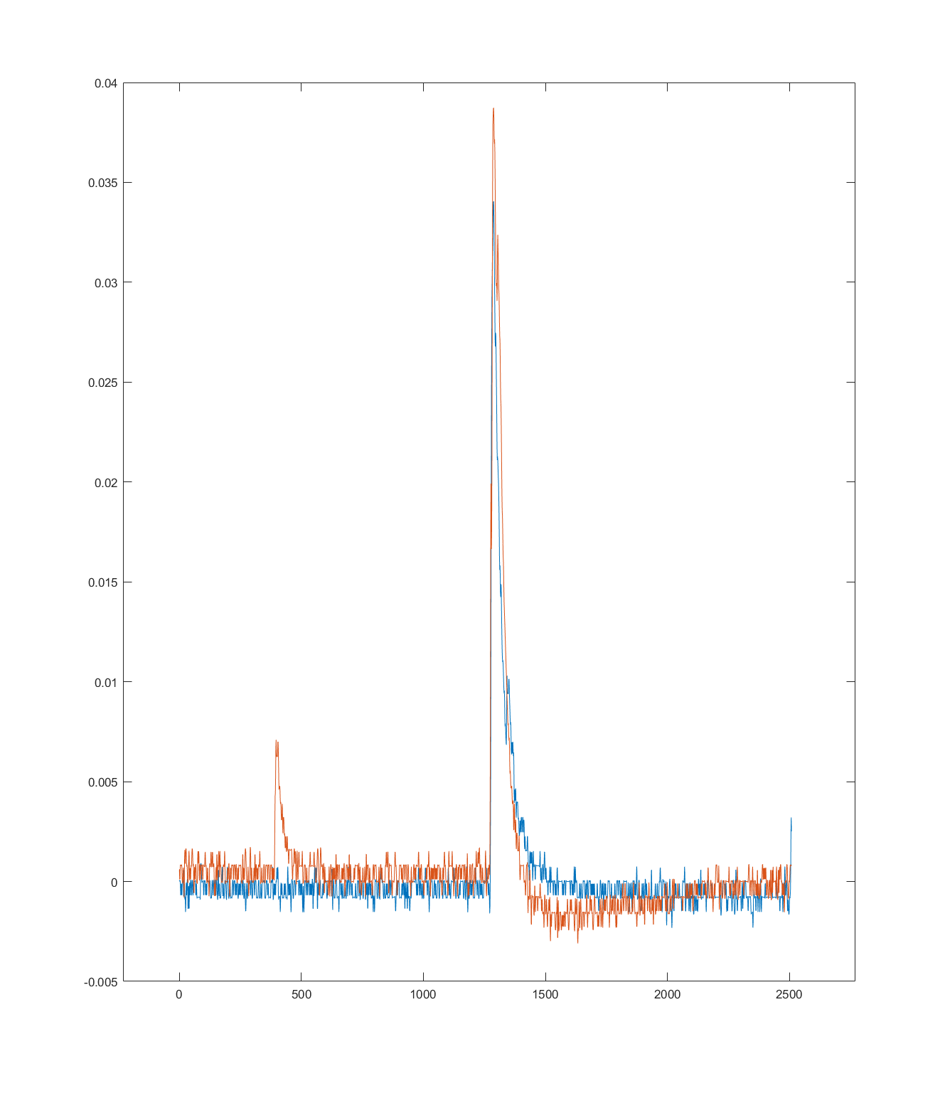
Cosmics
Amplitude (V)
Time (ns)

